Slide 1
Responsive enterprise mobile development
Day 4

Slide 2
recap
Notes:
We assigned 10 minutes to this topic.

Slide 3
REcap
jQuery Animation and CSS Selectors
Knockout and AngularJS
Styling Lab: Getting from Wireframes to Views with SASS/Compass
Ad Hoc OTA Deploys
Unit Testing with Jasmin, SinonJS, Karma and PhantomJS
AngularJS
KnockoutJS

Slide 4
On the dance card for today
Achieving Delight with Hybrid
AFNetworking
Core Data
LAB: Build a HTTP Intercept Request Operation
Objective-C Dependency Injection
LAB: Objective-C Unit Testing
Authentication
.NET / Java to Objective-C Pattern Mapping
Inheritance and Composition in Javascript

Slide 5

Achieving delight with hybrid
Notes:
We assigned 55 minutes to this topic.

Slide 6
Achieving delight with hybrid
Cleaning up UIWebViews to make them look and feel like mobile
Remove Scroller
K.D.S.S.! (keep the DOM stupid simple)
Repaint and Reflow
Transitions & animation
Github
Notes:
Removing background in UIWebView
Remove scroller
Keep the DOM simple
Repaint and Reflow
Transitions?
Animation
Show Sencha Canvas example? Maybe show vid?

Slide 7

AFNetworking
Notes:
We assigned 30 minutes to this topic.

Slide 8
AFNetworking
An HTTP Client for Objective-C
What do we need it for???
Examples

Slide 9


Core Data
Notes:
We assigned 60 minutes to this topic.

Slide 10
Core Data
An Object Graph Framework for Objective-C
Entity Designer
Relationships
Go Fetch! - Predicates

Slide 11
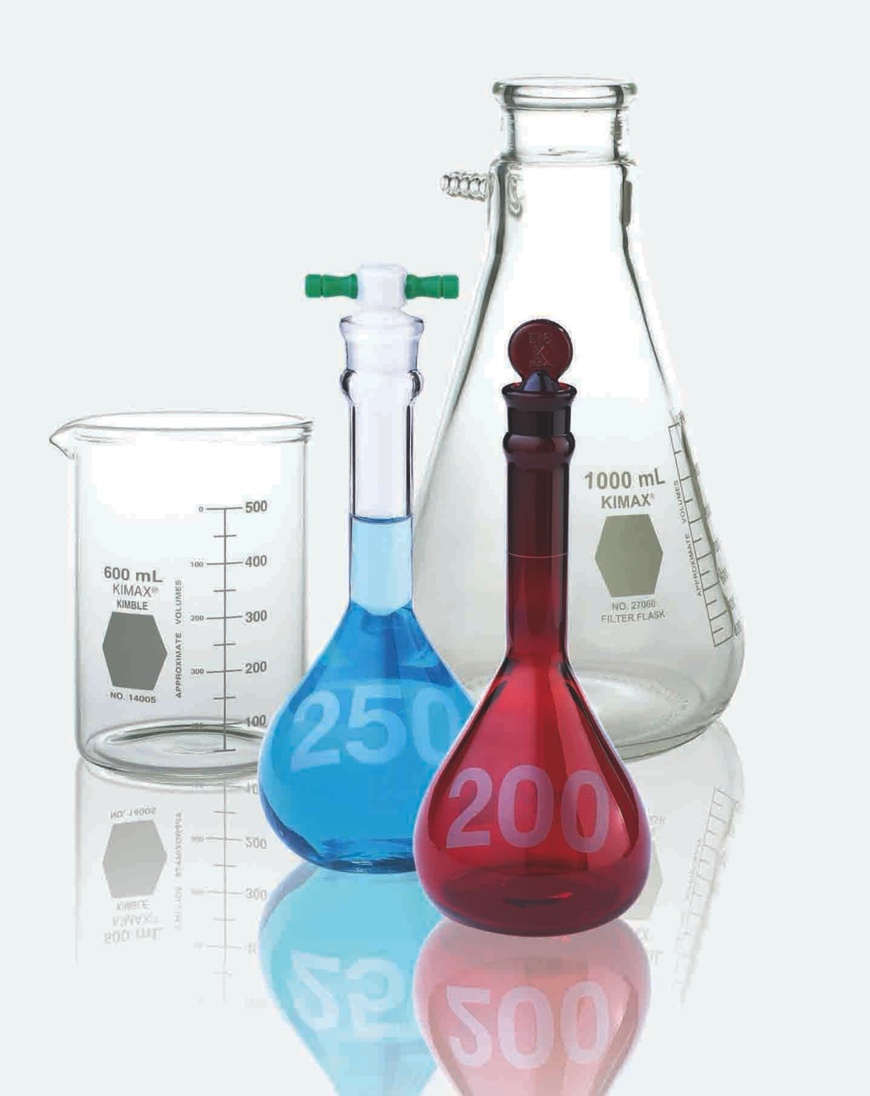
Lab: Javascript to native bridging with Http request intercepts and core data
Notes:
We assigned 2 hours to learn about it and do this lab.

Slide 12
The Bridging lab will focus on:
HTML / CSS
HTML5
SASS / COMPASS
LIVE EDIT
JAVASCRIPT
JASMINE
REQUIREJS
SINONJS
BACKBONE / UNDERSCORE
JQUERY
KARMA
PHANTOMJS
iOS - OBJECTIVE-C
UIWEBVIEW
AFNETWORKING
CORE DATA

Slide 13




Tools we’ll be using
HTML / CSS
Safari
JetBrains WebStorm
Chrome
JAVASCRIPT
Safari
JetBrains WebStorm
Chrome
iOS - OBJECTIVE-C
JetBrains AppCode

Slide 14
Lab: Javascript to native bridging with Http request intercepts and core data
Let’s write an intercept for the
/scavs/[scav name] GET endpoint
Notes:
Lab details slide

Slide 15
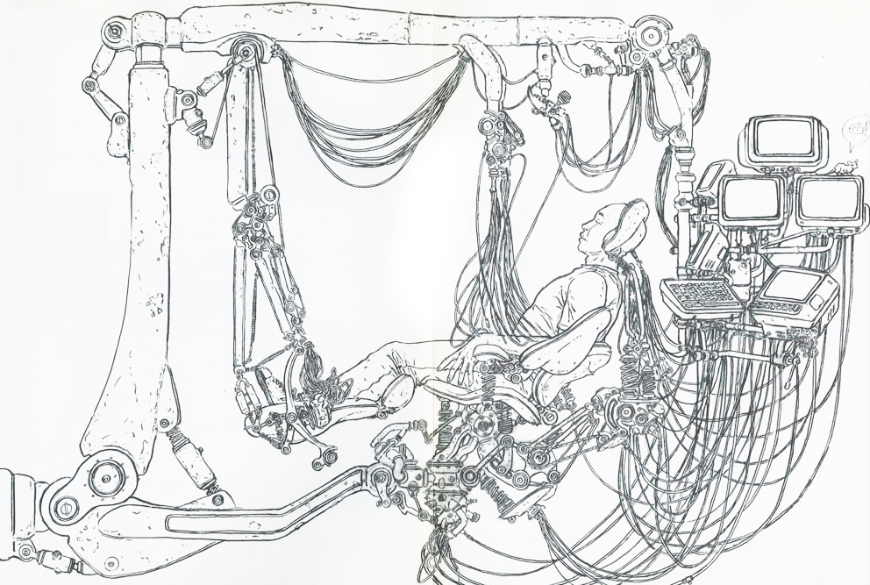
Objective-C dependency injection
Notes:
We assigned 55 minutes to this topic and the simple lab which follows.

Slide 16
Objective-C dependency injection
Typhoon
Objection

Slide 17
Lab: Objective-C dependency injection
Notes:
Do we need this as a lab? If you don’t have time to develop this lab, just remove this slide and the next two.

Slide 18
Lab: Objective-C dependency injection
You can probably already tell what you are going to do in this lab.
Notes:
Lab purpose slide

Slide 19
The dI lab will focus on:
HTML / CSS
HTML5
SASS / COMPASS
LIVE EDIT
JAVASCRIPT
JASMINE
REQUIREJS
SINONJS
BACKBONE / UNDERSCORE
JQUERY
KARMA
PHANTOMJS
iOS - OBJECTIVE-C
CORE DATA
TYPHOON

Slide 20
Tools we’ll be using
HTML / CSS
Safari
JetBrains WebStorm
Chrome
JAVASCRIPT
Safari
JetBrains WebStorm
Chrome
iOS - OBJECTIVE-C
JetBrains AppCode

Slide 21

unit testing Objective-c
Notes:
We assigned 2 hours to learn about it and do this lab.

Slide 22
Ios unit testing
XCTest
GHUnit
Mocking
OCMock
OCMockito
Notes:
Lab purpose slide

Slide 23
Lab: unit testing xctest / ocmock
Notes:
We assigned 2 hours to learn about it and do this lab.

Slide 24
The unit test lab will focus on:
HTML / CSS
HTML5
SASS / COMPASS
LIVE EDIT
JAVASCRIPT
JASMINE
REQUIREJS
SINONJS
BACKBONE / UNDERSCORE
JQUERY
KARMA
PHANTOMJS
iOS - OBJECTIVE-C
OBJ-C MOCKS
XCTEST
CORE DATA
TYPHOON

Slide 25
Tools we’ll be using
HTML / CSS
Safari
JetBrains WebStorm
Chrome
JAVASCRIPT
Safari
JetBrains WebStorm
Chrome
iOS - OBJECTIVE-C
JetBrains AppCode

Slide 26
Lab: unit testing XCTest OCMock
Let’s write a test
Notes:
Lab details slide

Slide 27

Authentication
Notes:
We assigned 45 minutes to this topic.

Slide 28
Authentication
Server-side
Tokenization
Local tokenization
2 – phase authentication
Notes:
For server-side, discuss Oauth, Spring MVC
For 2 phase, show vid

Slide 29
Authentication
DEMO
Notes:
For server-side, discuss Oauth, Spring MVC
For 2 phase, show vid

Slide 30
Lab: Authentication
Notes:
We assigned 2 hours to learn about it and do this lab.

Slide 31
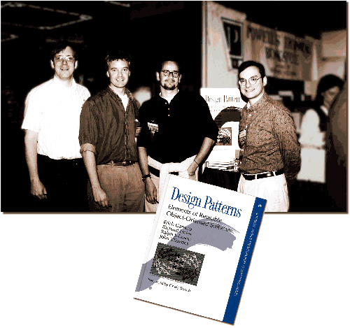
.NET/Java pattern mapping
Notes:
We assigned 60 minutes to this topic.

Slide 32

.NET/Java pattern mapping
Start here: http://www.apress.com/9781430233305

Slide 33

.NET/Java pattern mapping
For javascript, start here:
http://addyosmani.com/blog/learning-javascript-design-patterns/

Slide 34
.NET/Java pattern mapping
Inheritance
Singleton
Proxy
DDD
Bridge
Factory
Notes:
Talk about having no notion of an abstract class

Slide 35
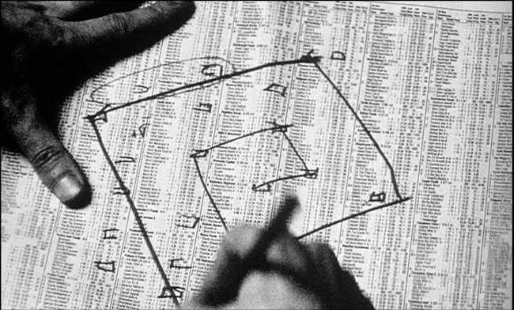
JavaScript Inheritance Composition + more
Notes:
We assigned 60 minutes to this topic.
Show BaseView, mixin in DAS.

Slide 36
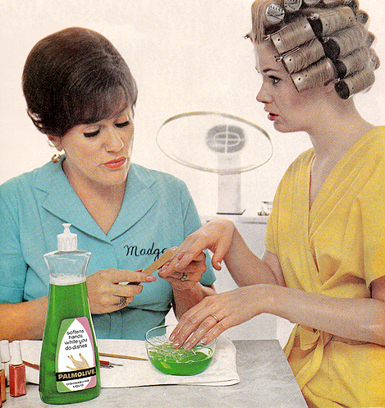
JavaScript inheritance composition + more
Inheritance in Backbone. You’re soaking in it.
Composition
Mediator
Mixin
Command
Notes:
Maybe talk about Aura for the Mediator stuff

Slide 37
That’s enough for today.
We start again tomorrow at 8:30.

